Slide 1
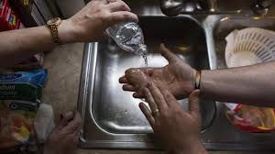
Spatial Project—The Socioeconomic Costs of Water Pollution in City of Flint, Genesee County
Presented by: Andrew Hall, Adeline Yuan

Slide 2
Background:
Flint is situated in Genesee County and, along with the county, endured a significant water crisis.
On April 25, 2014, Flint switched its municipal water supply from Lake Huron, supplied by Detroit, to the Flint River, initiating a series of pollution problems.
It was not until October 2016, Flint residents were cautioned against consuming tap water without passing it through an NSF International-certified filter for lead removal.
Even though Flint reconnected to Detroit's water system in the same month, the damage to public health and potentially to the local economy had already been inflicted.

Slide 3

Effects of Drinking Contaminated Water
Child health
Legionnaires' disease
Hair loss
Skin rashes

Slide 4
Water Measurement Indicators:
Conductivity: Freshwater is usually between 0 and 1,500 uS/cm and typical sea water has a conductivity value of about 50,000 uS/cm. However, the water quality in Genesee County is a bit higher than the standard of freshwater based on the dataset we got.
Orthophosphate: Orthophosphate is available as phosphoric acid, in salt form (potassium or sodium), and as zinc orthophosphate. Orthophosphate reacts with lead and copper to form compounds that have a strong tendency to stay in solid form and not dissolve into water. Genesee County is required to keep the orthophosphate residual level between 3.1 milligrams per liter (mg/l) and 3.7 mg/l to minimize corrosion. But City of Flint has not achieved this standard level.

Slide 5
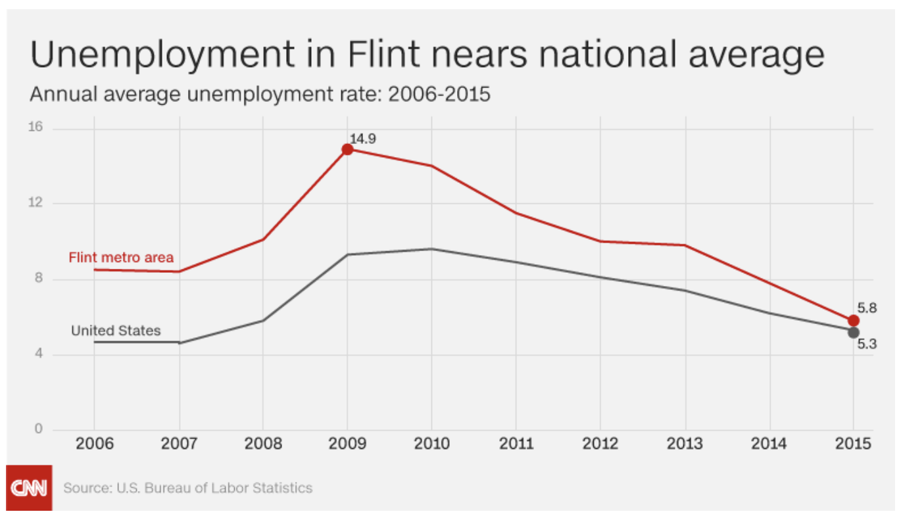
Economic Motivation—Unemployment rate
According to CNN, “ Flint was beginning something of a comeback before the water crisis hit. Crime rates were finally dropping. Unemployment rates in 2015 were down…”
As of July 2023, Unemployment remains at 10.2

Slide 6
Methodology:
Data:
Unemployment value change: The Bureau of Labor Statistics within 2021 to 2022
Water quality monitoring: Michigan Gov.com 2021, May -2022, May
Tools:
ArcGIS, STATA
Model:
Unemployment = a + B₁Conductivity + B₂Othophosphate + B₃Race + u

Slide 7
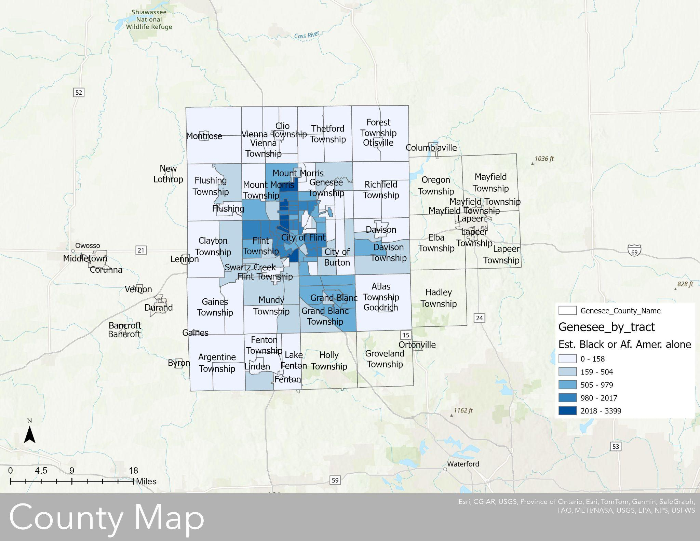

Slide 8
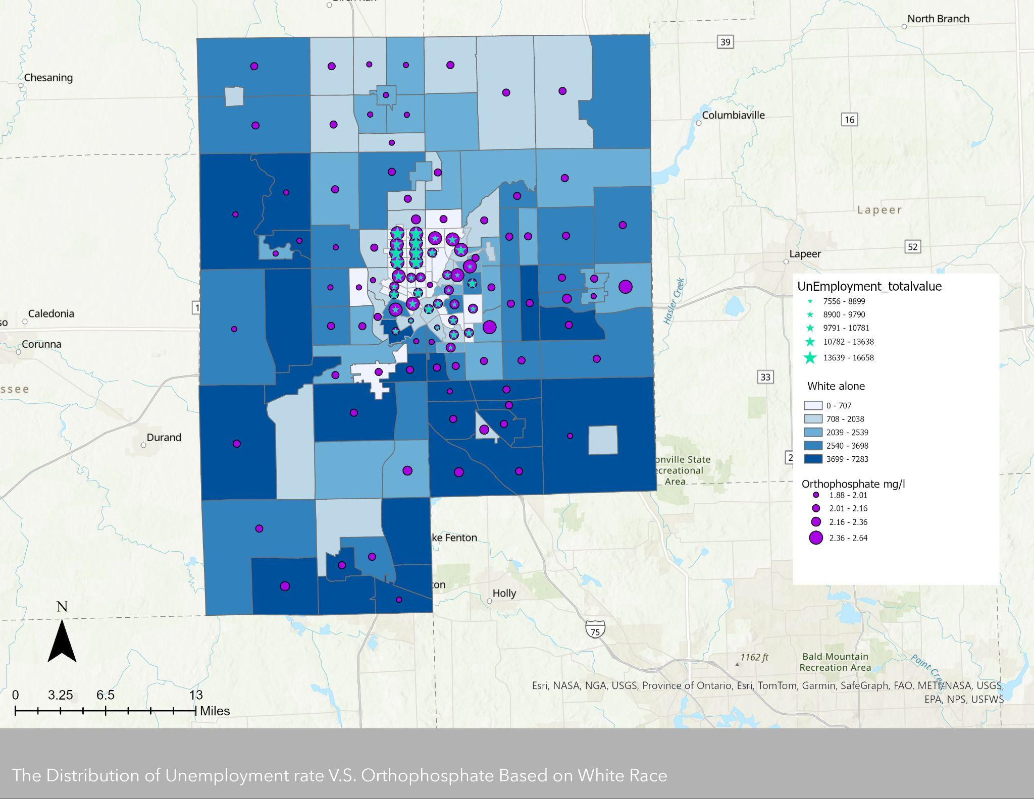
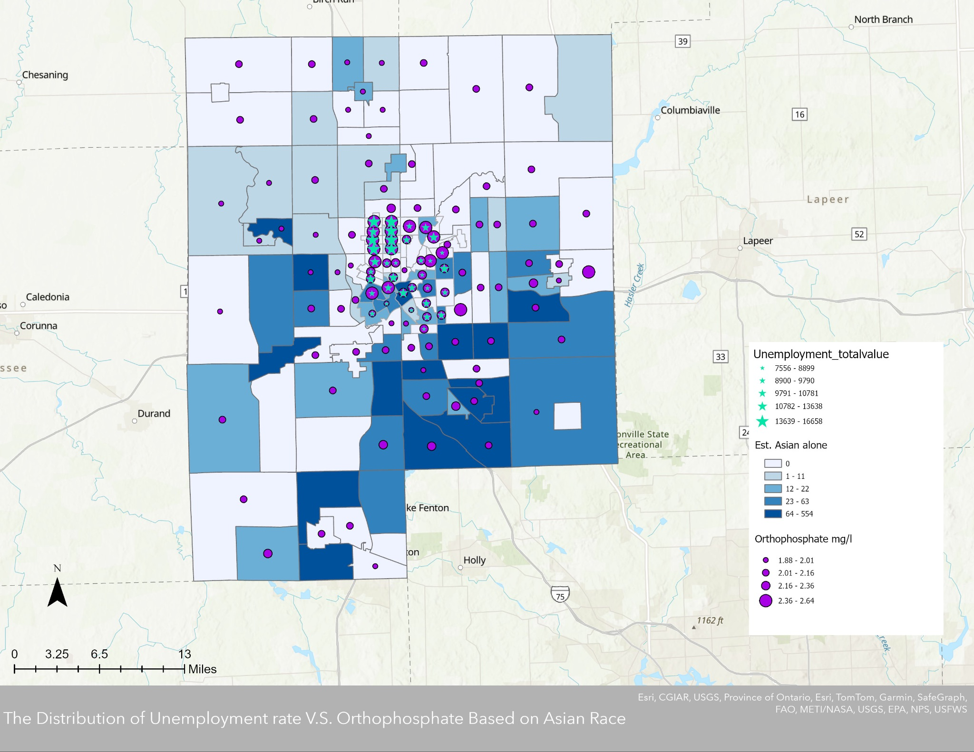
Spatial Results:

Slide 9
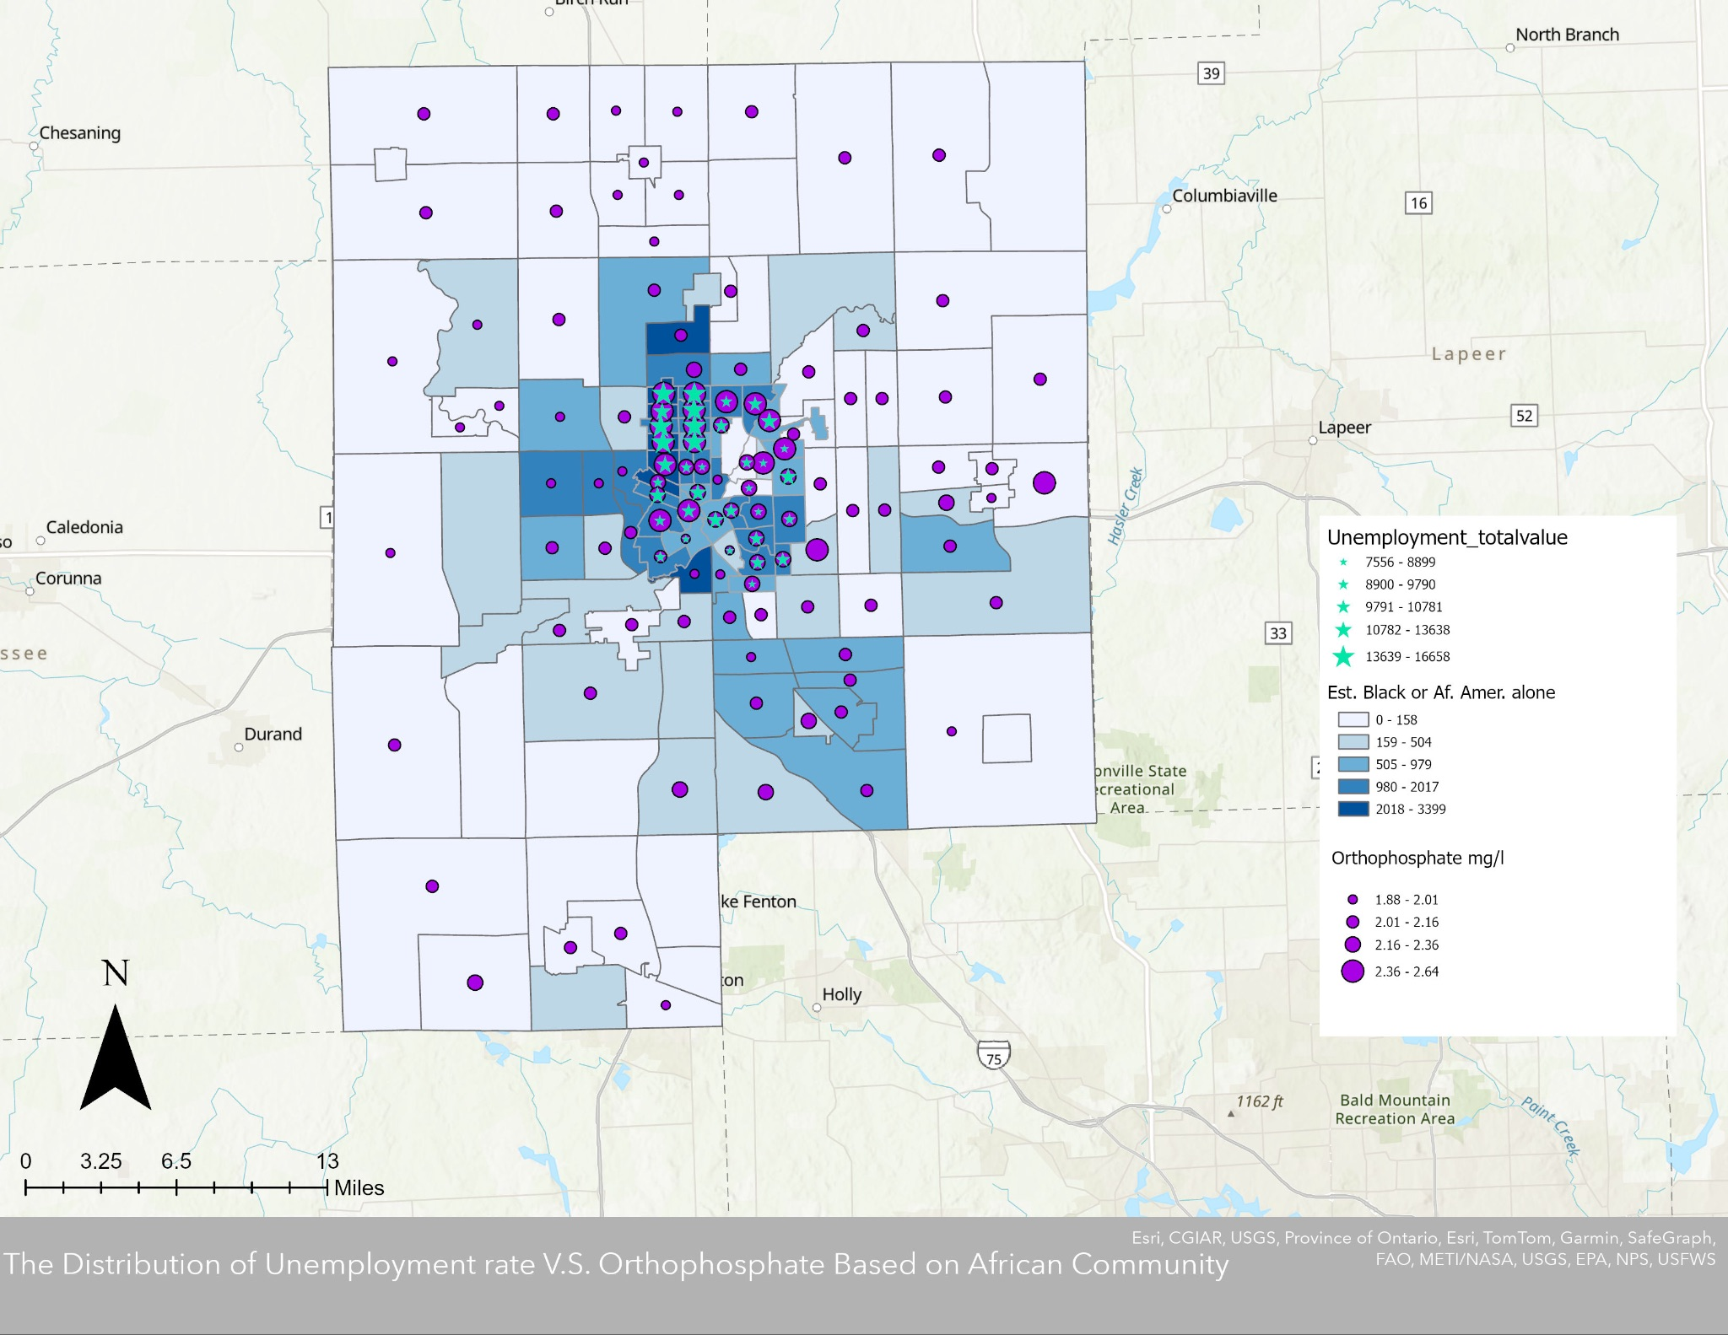
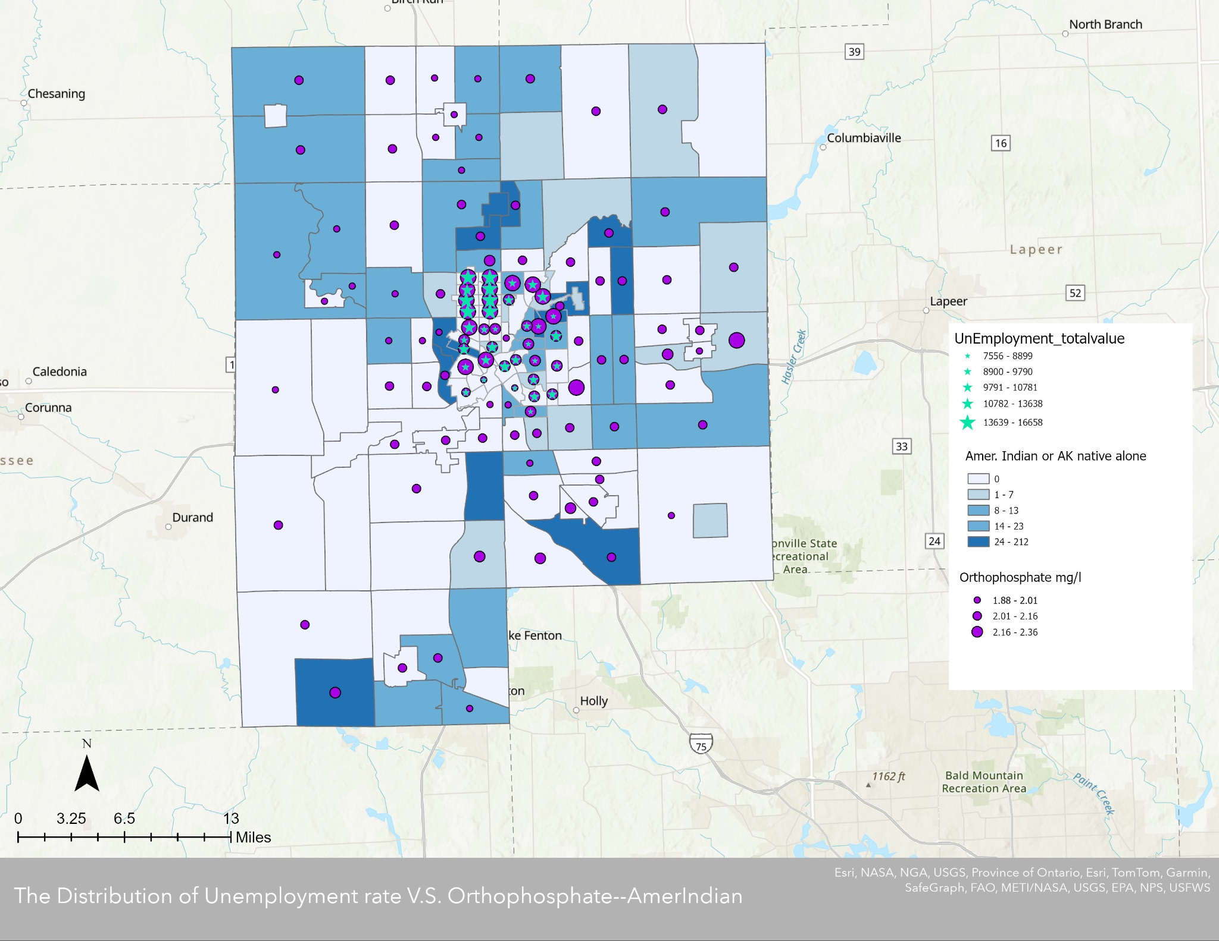

Slide 10

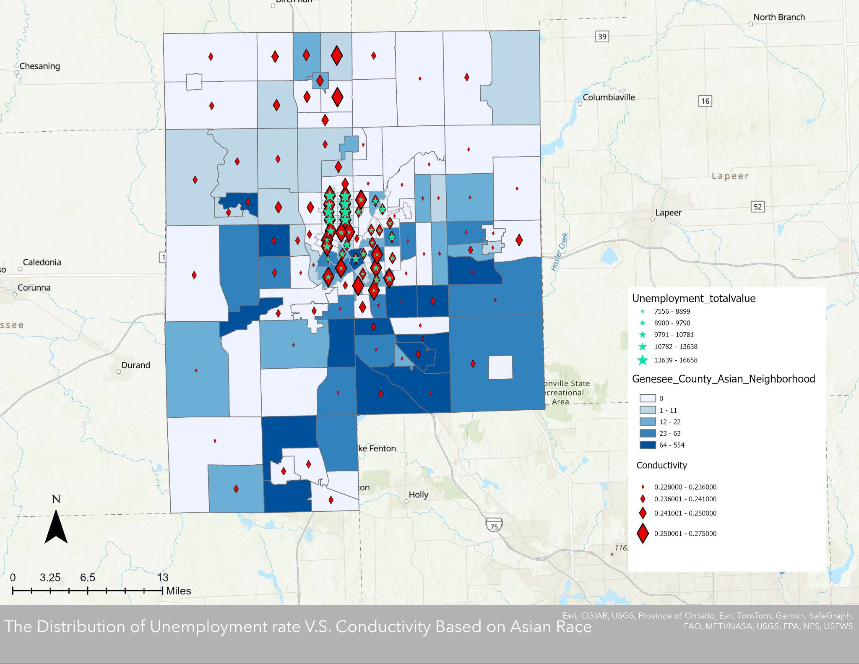

Slide 11
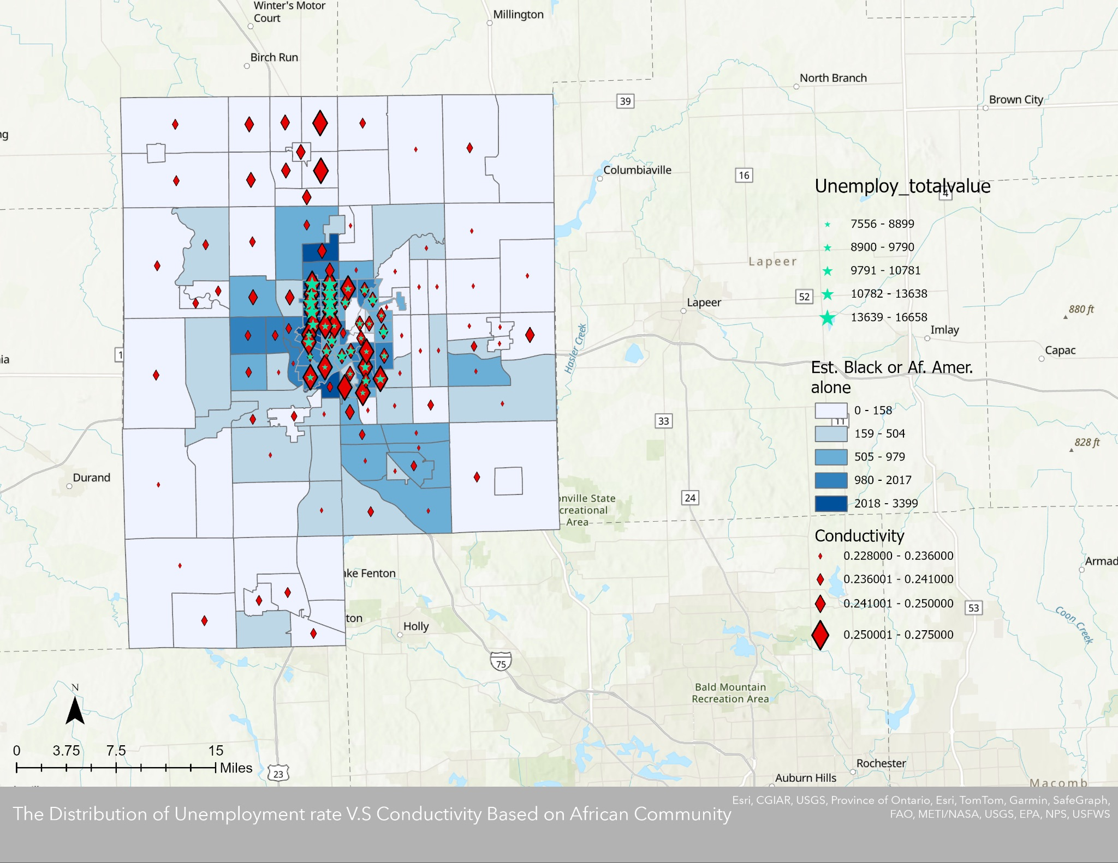
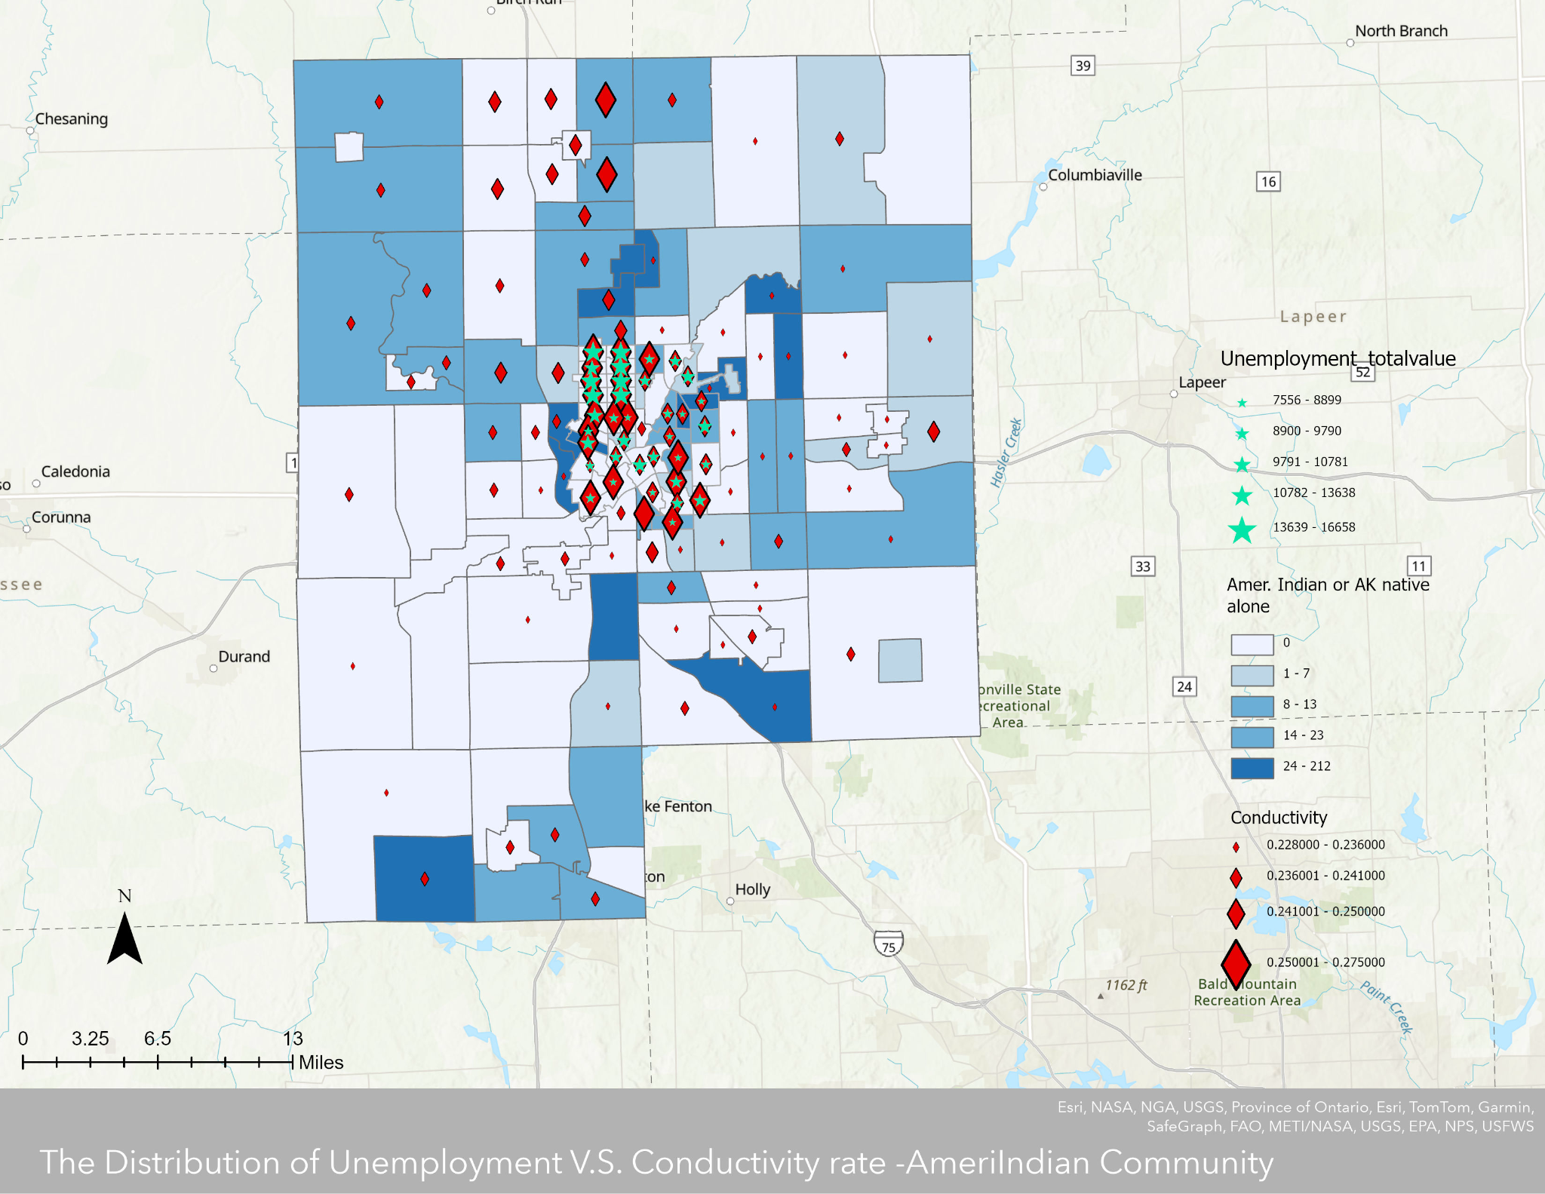

Slide 12
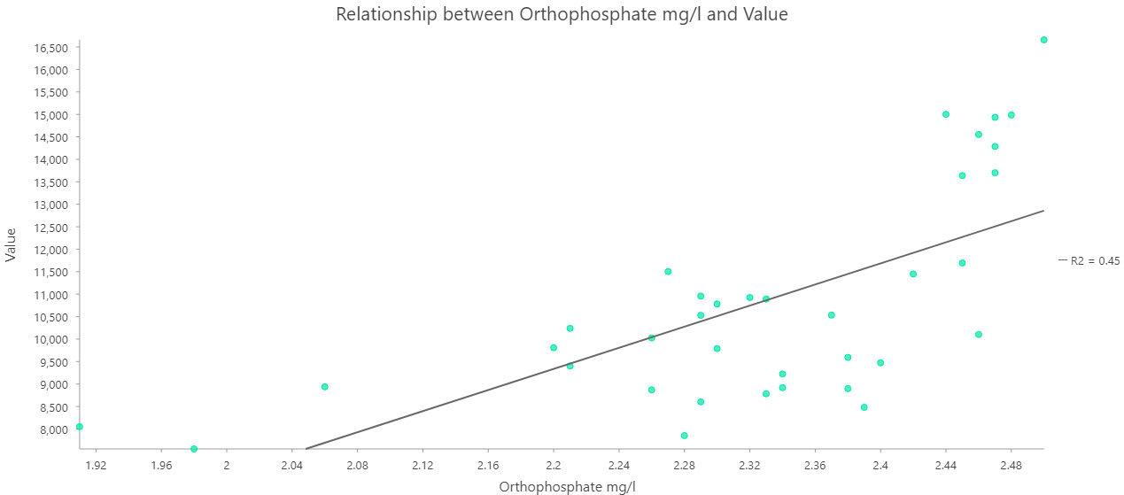
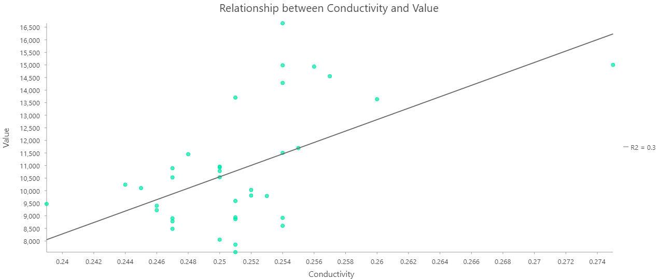
Linear Regression:

Slide 13
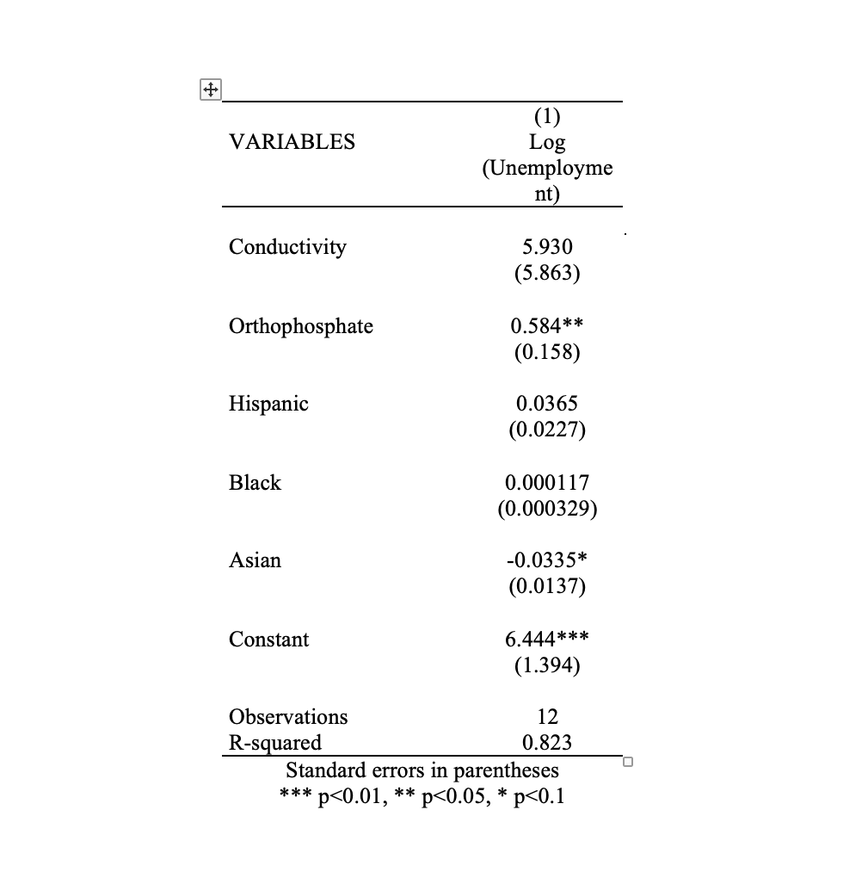
Econometrics Results:

Slide 14
Limitation for further study & Improvements:
Small sample size
Better identification strategy
Including health data or/and number of closed businesses

Slide 15
References:
https://www.cnn.com/2016/03/06/us/flint-problems-unemployment-poverty-crime/index.html
Denchak, Melissa “Flint Water Crisis: Everything You Need to Know” , Nov 8, 2018
https://www.nrdc.org/stories/flint-water-crisis-everything-you-need-know#summary
Atkin, Emily “Did Flint’s Water Crisis Damage Kids’ Brains?” Feb 14, 2018 https://newrepublic.com/article/147066/flints-water-crisis-damage-kids-brains
Water Quality Standards. https://mrccc.org.au/wp-content/uploads/2013/10/Water-Quality-Salinity-Standards.pdf
City of Flint Distribution System Monitoring Data ttps://www.michigan.gov/flintwater/water-infrastructure-projects/monitoring/wqa-flint-dist#:~:text=Flint%20is%20required%20to%20keep%20the%20orthophosphate%20residual%20level%20between,mg%2Fl%20to%20minimize%20corrosion.
Sam Trejo, Gloria Yeomans-Maldonado, Brian Jacob, Samuel Owusu, “Understanding the Psychosocial Effects of the Flint Water Crisis on School-Age Children in Michigan” May 2022
https://edpolicy.umich.edu/research/epi-policy-briefs/understanding-psychosocial-effects-flint-water-crisis-school-age

Slide 16
Thank you!!:)

